Slide 1
Earning Money

Slide 2
How can we earn money?

Slide 3


Salary
Fixed amount paid per annum.

Slide 4


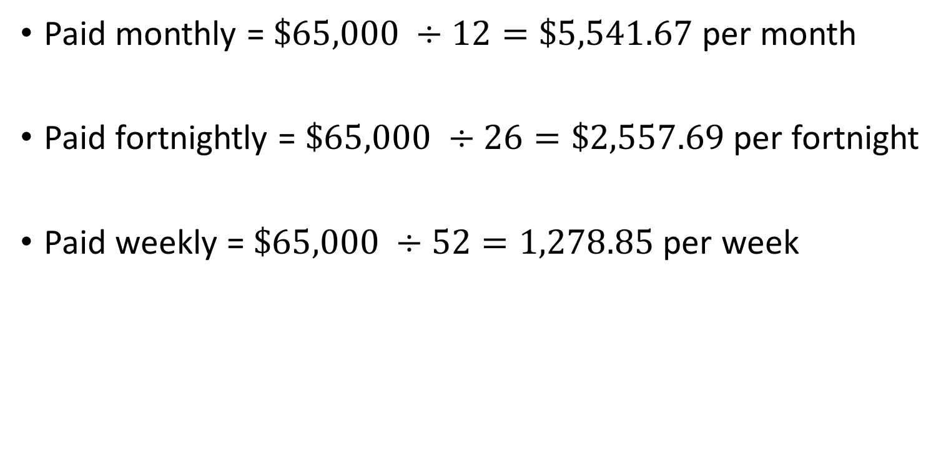

Salary - $66,500 p.a.
Paid monthly = $\$65,000 ÷12=\$5,541.67$ per month
Paid fortnightly = $\$65,000 ÷26=\$2,557.69$ per fortnight
Paid weekly = $\$65,000 ÷52=1,278.85$ per week

Slide 5
Wages
Paid by a particular quantity of work– could be hourly rate, piecework or commission, not a set annual salary.
Hourly rate
Particular quantity – hour
e.g. $24 per hour,
Higher rate if over normal hour
working over 8 hours per day
working on Saturday and Sunday

Slide 6
Mon
Tue
Wed
Thu
Fri
Sat
Sun
Weekdays:
Normal hourly rate for the first 8 hours
Additional time – overtime, 1.5 hourly rate
Weekend:
Saturday – 1.5 hourly rate
Sunday – 2.0 hourly rate

Slide 8
Wages - piecework
Quantity
Not hourly
Could be a piece of work
Examples:
Picking fruits – paid by mass of fruits they pick
Number of T-shirts a worker sown per day
Packing hamper during Christmas – paid by number of hampers packed

Slide 9


Examples
A backpacker earns his living by picking grapes. He is paid $0.80/kg of grapes he picked. How much would he made if he picked 80 kg in 2 hours?

Slide 10
Wages - commission
Based on the sale price (fess charged by some business for selling an item)
e.g. selling real estate
Could also be based on the quantity of sales
e.g. selling cars – number of cars sold.
Commissions are usually a PERCENTAGE of the values of the sales

Slide 11

Examples
Richard, a real estate agent charge 2% as a commission from the sales price of the real estate he sells. If he sold a house for $825,000, what is his commission?

Slide 12




Examples
A car salesman is paid a retainer of $2000 per month and a commission of 2.1% of the total sales in a month. If he sold a total of $210,000 in January, how much would he made?

Slide 13




Example – stepped commission
An auction house charged the following commission:
5% of the first $10,000
2% of the next $15,000
1% of the next $15,000
0.5% thereafter.
What would the commission be if the auction house sold an antique vase for $50,000?

Slide 14
Notes:
http://t-a-x.net/tag/income-tax/page/2/
http://1globaltax.com/taxpreparation.php

Slide 15
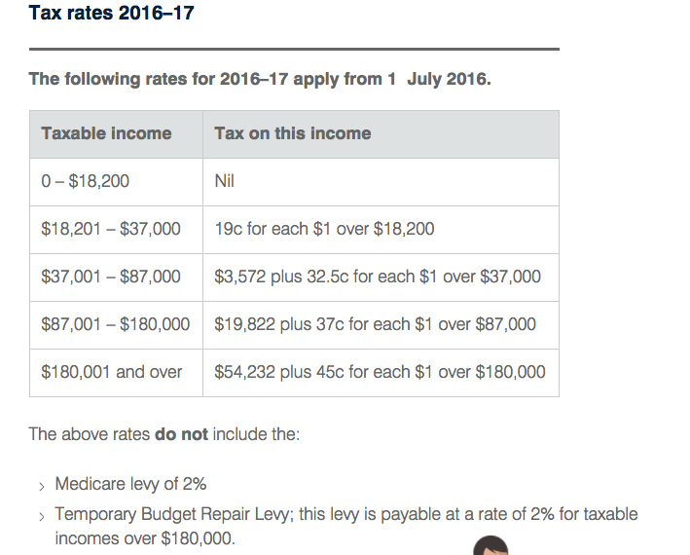
Table obtained from the Australian Taxation Office website.
Notes:
https://www.ato.gov.au/rates/individual-income-tax-rates/

